Slide 1

E-HEALTH CARE APPLICATION
SUBMITTED BY:
K.RAMYA CHOWDARY
192011288

Slide 2
AIM : TO EVALUATE THE E-HEALTH CARE APPLICATION'S BEHAVIOUR AND REQUIREMENTS

Slide 3
REQUIREMENTS
INTERNET CONNECTION
USERNAME(MOBILE NO OR EMAIL ID)
PASSWORD
WEBSITE(https://www.apollo247.com/)

Slide 4
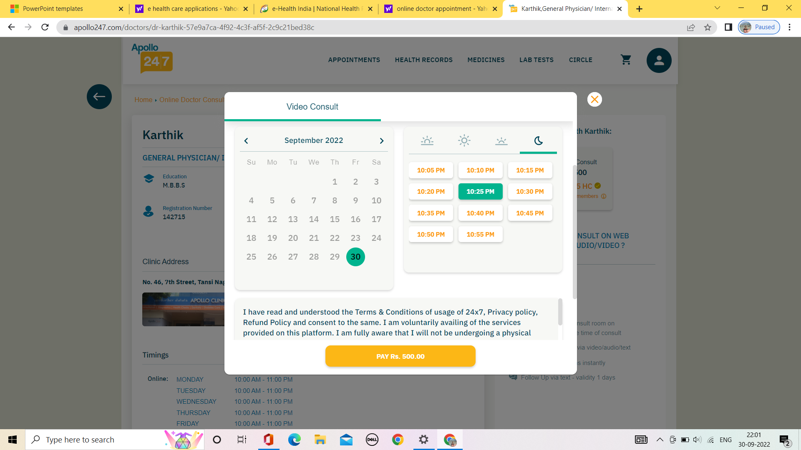
PAYMENT AND BILLING

Slide 5
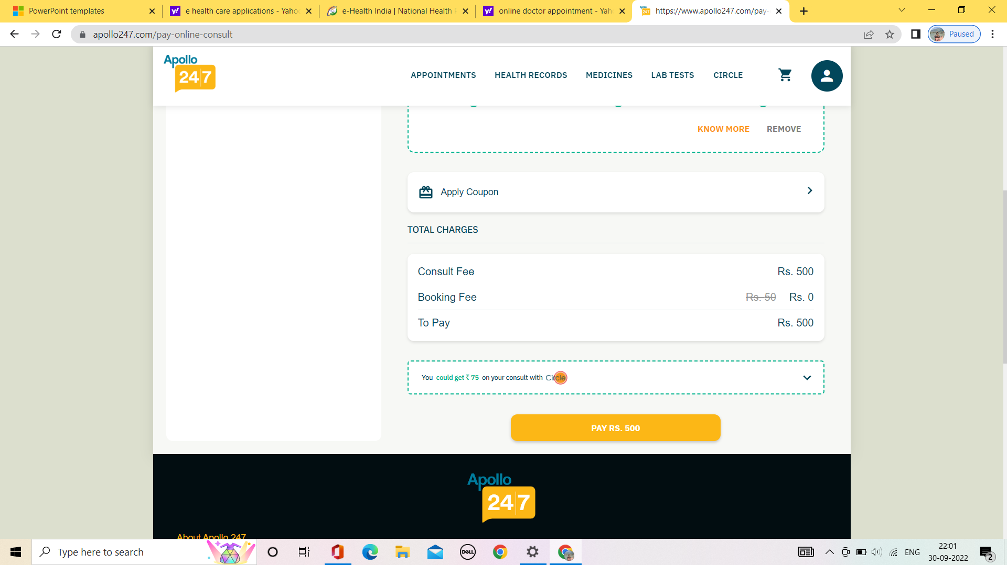

Slide 6
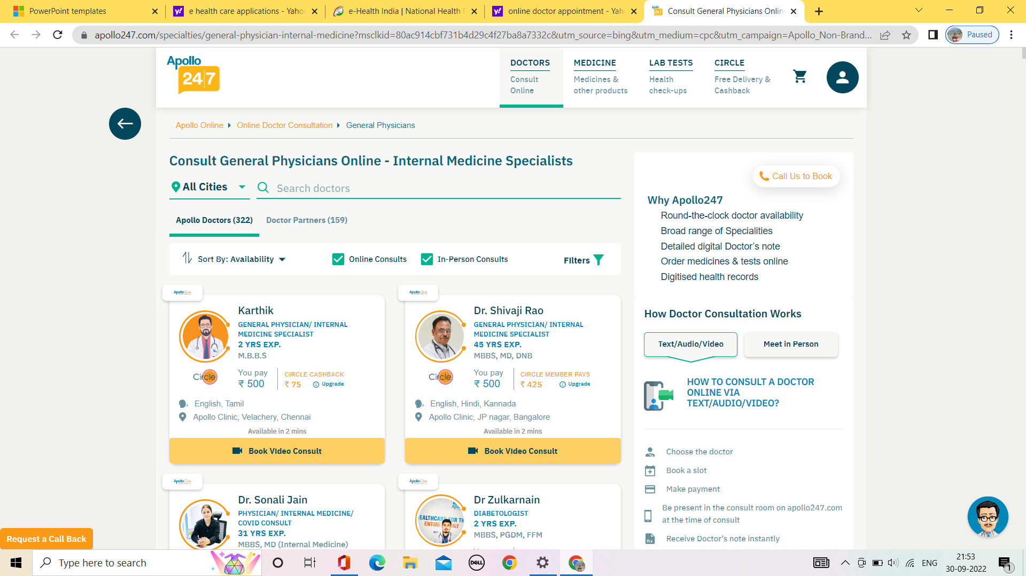
ADDING DOCTOR PAGE

Slide 7
POSITIVE SCENARIO'S
Check if the payment successful then user can access the doctor
Check if all the payment and billing record are be saved or not
Check if only authorized user can add doctor and access the records and data
Check if adding the doctor is possible if user has valid id
Check if the user can also add a doctor based on previous medical history
Check If the details of new doctors are added and updated
Check if once doctors added the record can't be deleted
Check if users record can be deleted from the record after payments
Check if the copy of bill is generated and saved in history
Check if the bills and payments of a user are up to date

Slide 8
NEGATIVE SCENARIO'S
Check if the payment failed then user can add the doctor
Check if all the payment and billing can be accessed by external people
Check if only unauthorized user can access the records and user details
Check if adding the doctor is possible if user has invalid id
Check if the user can remove a doctor once payment is processed
Check If the doctor is added but the payment is pending user can access or not before payment
Check newly added doctors record can be changed or duplicated
Check if user history record can be deleted after adding doctor
Check if the copy of bill is generated and saved in history can delete
Check if the bills and payments are done without authentication

Slide 9
TEST CASES
TEST CASE | PASS/FAIL
Check if adding the doctor is possible if user has valid id | PASS
Check if all the payment and billing record should is recorded or not | PASS
Check if once doctors added the record can be deleted | PASS
Check if the copy of bill is generated and saved in history | PASS
Check if the bills and payments of a user are up to date and maintained | PASS
Check if the payment failed then user can access the doctor | FAIL
Check if unauthorized user can access the records and change payments | FAIL
Check if the bills and payments are done without authentication | FAIL
Check if the copy of bill is generated and saved in history can delete | FAIL
Check If the doctor is added but the payment is pending user can access or not before payment | FAIL

Slide 10
Conclusion
I have finally navigated the apollo web application and find out the positive and negative i.e pass/fail test cases. This is to improve the applications performance in better manner and works best

Slide 11

THANK YOU

